Slide 1

Mini Project –Semester V Internal Presentation Part - 1
ONLINE CHILD VACCINATION BOOKING
by
Amit Kumar Amsa Konar Arnab Samanta
121A3004 121A3005 121A3007
Prerna Mumbaikar
121A3029
Under the guidance of
Prof. Savita Lohiya
Department of Information Technology
SIES Graduate School of Technology, Nerul

Slide 2
Introduction
In a world where health and safety have taken center stage, ensuring timely and convenient access to vaccinations for children is paramount.
The "Child Online Vaccination Booking Project" is a visionary initiative designed to streamline the process of scheduling and managing vaccinations for children, making it hassle-free for parents and caregivers.
This project harnesses the power of technology to create a user-friendly platform that simplifies the entire vaccination experience.
Project Title

Slide 3
Literature survey
Study Title | Authors | Year | Key Findings
"Impact of Online Appointment Systems on Healthcare Access" | Smith, J. et al. | 2018 | - Online appointment systems significantly reduce waiting times.
 |  |  | - Improved patient satisfaction with online booking options.
"Digital Health and Vaccination Scheduling: A Review" | Brown, A. et al. | 2020 | - Digital health tools have the potential to enhance vaccination scheduling.
 |  |  | - Emphasizes the importance of data security and privacy in online systems.
"Evaluating the Impact of Reminder Systems on Vaccine Uptake" | Garcia, M. et al. | 2019 | - Reminder systems, such as SMS and email, improve vaccine adherence rates.
 |  |  | - Timely reminders positively influence parents' decisions to vaccinate their children.

Slide 4

Existing system
1. Kiddo Health:
This provides details about vaccinations according to their age.
But do not provide online vaccination booking.
2. Apollo Cradle:
This website is for pregnant womens.
It also provide children vaccination details but this site also does not provide vaccination bookings.

Slide 5
Problem definition
The existing system provides the information about the vaccinations that should be given to the child according to their date of birth but fails to provide the facilities for vaccination for the kids by providing them with the best child specialist or pediatrician in their vicinity and according to their time.

Slide 6

Proposed system
Our proposed system contains online vaccination booking, according to their time slots.
We provide licensed and qualified doctors, nurses.
We provide details about each vaccine.
We provide locations of our branches.
We will be providing the price of the vaccines on the site according to the market price.

Slide 7
Hardware and software requirements
Software:
Visual Code Studio
Programming language:
Html
Css
Javascript
React
Db browser (Database)
Hardware:
Laptop/Mobile/Tab
Processor:
i5

Slide 8
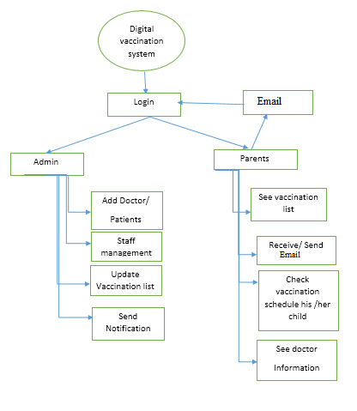
System Architecture

Slide 9

APPLICATION
Hospitals
Vaccination Centre
Child Hospitals
Social Organisation

Slide 10
References
https://www.apollocradle.com/vaccination/vaccination-schedule-and-the-diseases-they-protect-against/
https://kiddohealth.in/vaccination-schedule

Slide 11


